Slide 1
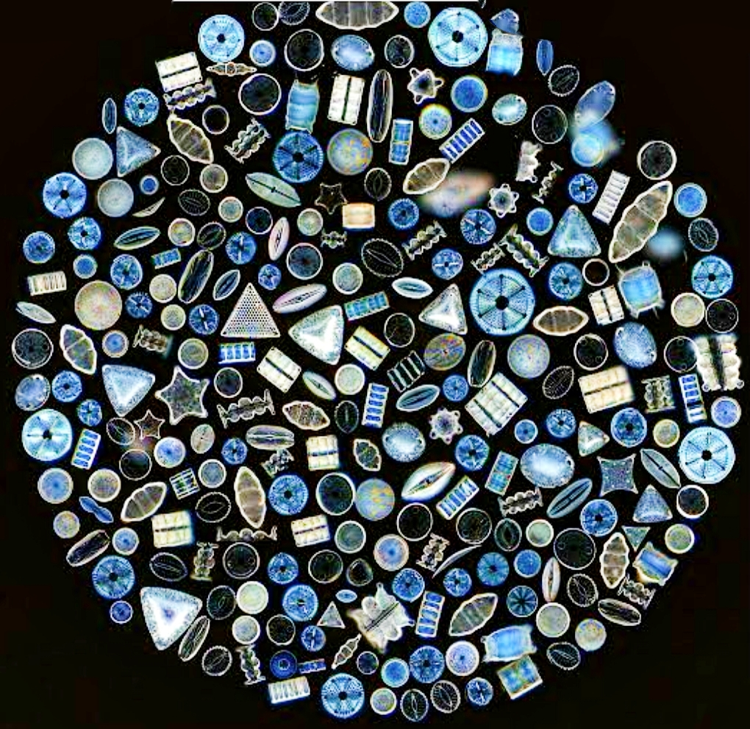
DIATOMS AND THEIR FORENSIC IMPORTANCE
Made by:
Sweta Bharti
(Assistant Professor)

Slide 2
INTRODUCTION DOMAIN – Eukaryota KINGDOM – Chromalveolata PHYLUM – Heterokontophyta CLASS – Bacillariophyceae ORDER – Pennales
Diatoms are microscopic, photosynthetic, eukaryotic algae that inhibit almost all bodied of water.
They are found in springs, rivers, ponds, lakes, ditches and in freshwater & marine water.
It occur in terrestrial habitats such as wet rocks, mossess and soils.
Study of diatoms is called Forensic Limnology.
TYPES-
a. CENTRIC – Which are radially symmetrical.
b. PENNATE – Which are bilaterally symmetrical.
EXTRACTION PROCEDURE –
a. NITRIC ACID METHOD b. SULPHURIC ACID METHOD
ADVANCED TECHNOLOGIES USED FOR DIATOMS DETECTION-
a. NMR b. Fluorimetry

Slide 3
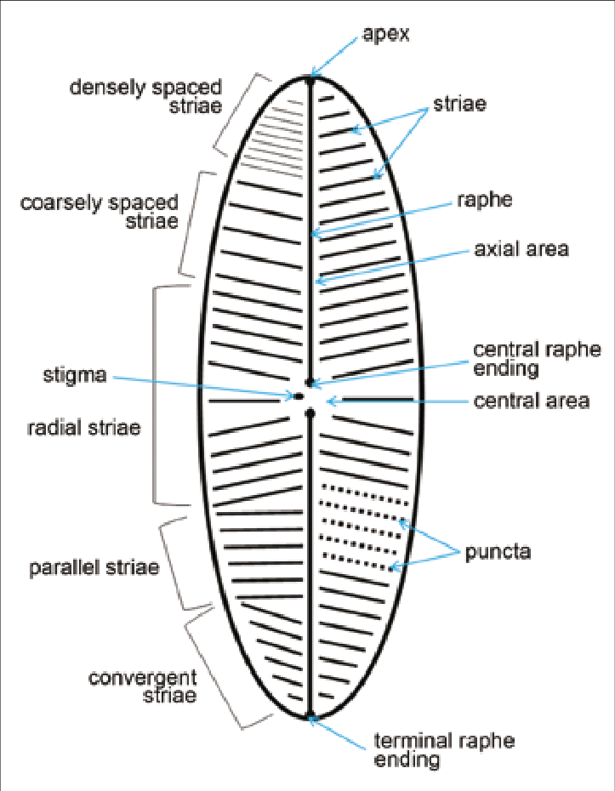
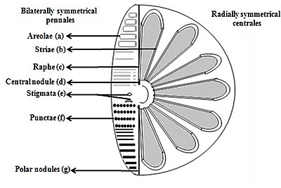
MORPHOLOGY
A.

Slide 4
FORENSIC SIGNIFICANCE
Presence of diatoms in the body tissues is very useful evidence for solving cases.
When dead body is recovered from water, there is always a question whether it was a case of ante mortem and post-mortem drowning. Thus, it determine whether it’s an ante mortem drowning or post mortem drowning.
In post-mortem drowning, (if person is dead when entering the water) then there is no circulation and the transport of diatoms cells to various organs is prevented because of lack of circulation & diatoms cannot enter the body.
In ante mortem drowning, (if person is still alive when entering the water) , then diatoms will enter the lungs if the person inhales water & drowns. The diatoms are then carried to distant parts of the body such as brain, kidneys, and bone marrow by circulation.

Slide 5
FORENSIC SIGNIFICANCE
Establishes corpus delicti . ( it establishes the fact that crime has been committed) [corpus delicti means body of the crime]
It links crime to the crime scene and victim and suspect because diatoms can be found on clothes and shoes or on skin the perpetrator to a scene.
It Identify the actual scene of occurrence ( For example- sometimes suspect kill the victim on some other place and then they just throw the body in the water).
It also Identify the type of drowning i.e. fresh water drowning or sea water drowning.
(Freshwater leads to quick absorption into blood from GIT due to lower osmotic pressure, it increases blood volume in short span of time that result in loss of red blood cell-hemolysis)
(In Saltwater having equal osmotic pressure to blood and it just slightly increases NaCl causing mild symptoms)

Slide 6
It will determine the location by comparing with the diatom species found in the body’s tissues with the diatoms from the known water source where the body was discovered.
It helps in indicating the seasons as well as year by understanding the seasonal patterns of diatoms population. Diatoms populations in water bodies can vary throughout the year due to seasonal changes and other environmental factors.
It estimate the approximate time since death by the movement of diatoms population inside the body. It is not a precise method because it is often combined with other approaches such as body decomposition stages, insect activity, temperature analysis.
Their silica- based skeletons do not readily decay and they are sometimes be detected even in heavenly decomposed bodies.

Slide 7
COLLECTION,EXTRACTION AND IDENTIFICATION
Collection - Directly from the shores in a sterelized bottle
- Through Plankton net.
Extraction - Acid Digestion Method
- Lefort Aqua Regia Method
ACID DIGESTION METHOD
1. Sulphuric Acid Method ( both from water and tissue samples)
2. Nitric Acid method (mostly for tissue and bone marrow samples)
LEFORT AQUA REGIA METHOD
Mixture of Nitric Acid to Hydrochloric Acid.

Slide 8
Limitations and Advantages
Diatoms can only tell when or where evidence was found in some situations and not the time of death if there is no body fluid sample available to be collected.
Without the inhalation of water and some circulation present in the victim, the diatoms will not be able to enter the alveolar system and blood stream making it difficult to extract a reliable sample.
Diatoms can also be destroyed based on the biological make up of the body it encounters, this could affect the results in a criminal investigation.

Slide 9
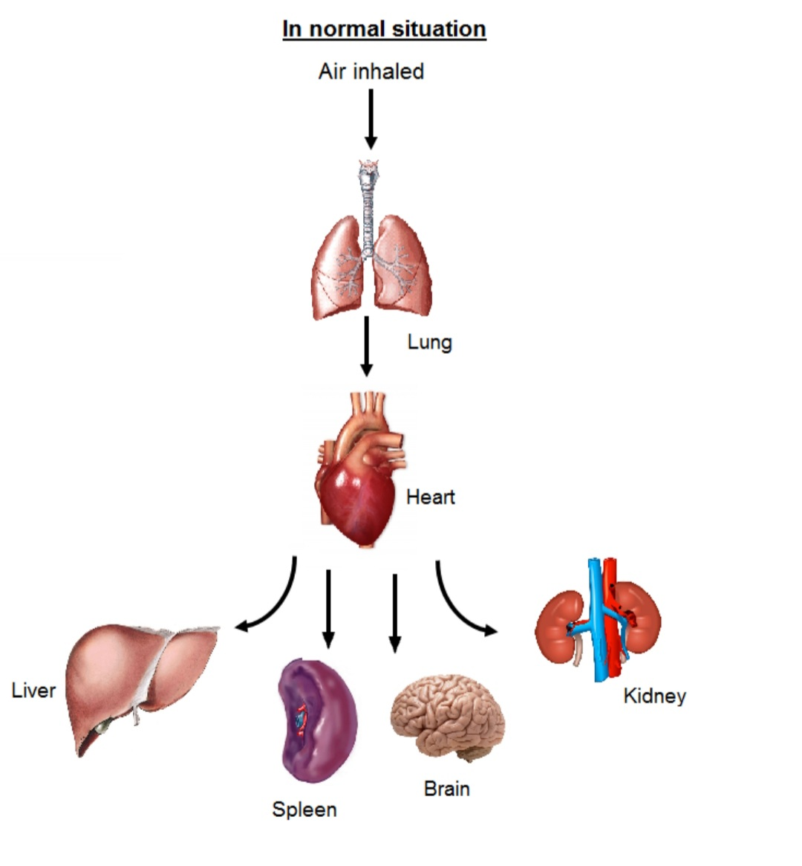
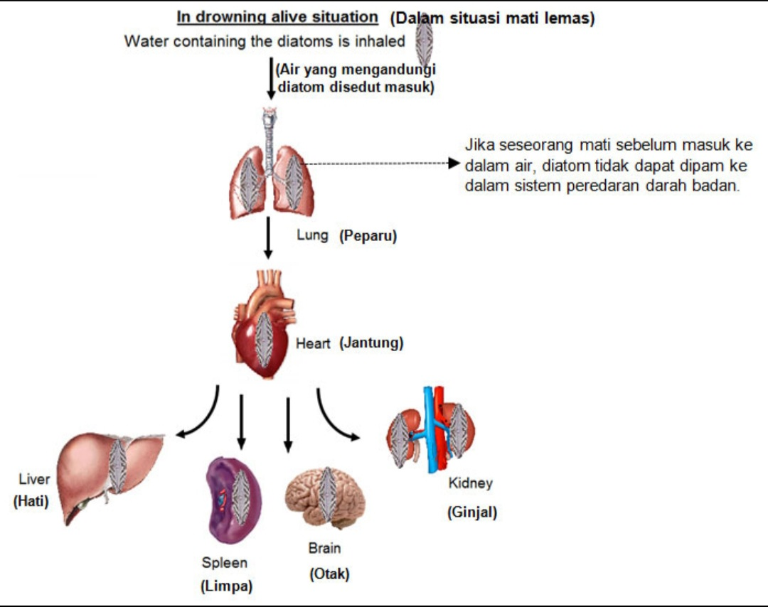

Slide 10
Indian case study:-
Case Name-shopian Rape and Murder case
Source- Journal of Forensic Medicine and Toxicology(year-2012; volume:29;Issue:2)
Case study:-
In the country's most high profile case “Shopian Rape and murder case” in which bodies of two female victims named ‘Asiya Jaan’ and ‘Neelofar Jaan’ were found in Rambiara water stream on 30thMay’2009 at Jammu and Kashmir. The investigations first declared it to be rape and murder. Later the case was sensitized in which the doctors opined that the hymen of deceased ‘Asiya Jaan’ was intact and the injury on the forehead was not enough to cause death. While another deceased ‘Neelofar Jaan’ was married on whom no antemortem injuries were found. The diatom test was conducted at Forensic Science Laboratory (Haryana) Madhuban which showed the presence of diatoms in the biological tissue samples of ‘Asiya Jaan’ and ‘Neelofar Jaan’ and in the water sample of the stream. After the diatom test medical doctors opined that death of two female victims was due to antemortem drowning.

Slide 11
International Case Report FORENSIC LIMNOLOGY: The Use of Freshwater Algal Community Ecology to Link Suspects to an Aquatic Crime Scene in Southern New Zealand
Year: 1994 (Journal of Forensic Science)
JULY, 1991- two young boys-brutally attacked by multiple teenage assailants while fishing at a sub-urban Connecticut pond.

Slide 12
EVENTS:
Victims accosted at knife point, bound with duct tape, beaten with a baseball bat and dragged into pond to drown.
One of the two victims freed himself and rescued his colleague.
The apparent motive for the attack was the theft of the victims’ bicycles.
Numerous items of physical evidences, which include footwear impressions, duct and electrical tape fragments and a submerged baseball hat, were left at the scene by the assailants helped in placing the suspects at the crime scene.
Reference samples obtained from: pond water, sediment and aquatic vegetation.

Slide 13
EXAMINATION:
(A). VISUAL/PHYSICAL EXAMINATION: of water-soaked clothing and footwear (sneakers) of both victims and suspects.
Observation: Sediment(s) of similar colour on the inner and outer surfaces of the footwear.
(B). LIMNOLOGICAL EXAMINATION:
1. Scrapping done to remove mud from the sneakers of both the victims and the suspects.
2. Mud from the pond reference sample was added to another beaker.
3. Sulfuric acid and Potassium dichromate were added to each beaker and the resultant slurries were allowed to settle for 24 hours.
4. Each slurries was then transferred to a centrifuge tube, placed into a water bath and boiled for 1 hour.
5. Each sample was rinsed with distilled water.
6. Pellets of each sample were dried onto a glass coverslip and mounted onto a glass slide with HYRAX.

Slide 14
7. Each slide was examined using phase contrast microscope (1000X)
8. Qualitative and quantitative analyses of the diatoms was done.
9. Statistical analysis of each sample was also done.
RESULT:
All samples contained diatoms and scaled chrysophytes.
All species found were of freshwater habitat. Hence, they originated from same waterbody.
CONCLUSION:
May 1992, all the three suspects entered guilty pleas to variety of felony charges and were subjected to lengthy period of incarceration.

